Slide 1
Short introduction into Rust
throught Linux pam

Slide 2



About me
senior software engineer
just started in cloud “architect” role
started at Balabit 2017
rust, python & many more
cloud services

Slide 3
The Project
Writing a linux pam module in rust
Authenticate a user in sudo via an external authentication web service

Slide 4

PAM
Linux Pluggable Authentication Module
Methods to configure how to authenticate a user in linux
Authenticate, authorization, session and user management
Notes:
Video: Nem találtam rá infót,hogy pontosan mikortól is jelent meg a PAM, de egy elég régi scrum daily-ről készült videón már említést tesznek róla.
A szigorú Scrum-master felhívja csapata figyelmét, hogy a kulcs az időzítés és az együttműködés.

Slide 5
Rust
Mozilla research project
Multi-paradigm, high-level, statically-typed compiled system programming language
Performance, memory and concurrency safety
FFI: foreign function interface
“Most loved programming language” – stack overflow (since 2016)

Slide 6
Rust: pros
Memory safety and performance
Option and result wrappers, pattern matching
No fully OOP, traits instead (shared behaviour)
No garbage collection, borrow checking instead
Easy concurrency and threading
Pleasing (c/c++ like) syntax
Cummunity and rich ecosystem, package manager, plenty of external packages

Slide 7
Rust: cons
Not so easy to learn, long learning-curve
Young language, still evolving
No fast, throwable prototyping (like in python)
Hard to refactor or modify ‘legacy’ code

Slide 8
Cargo
Rust package manager and development toolchain
Commands (eg)
cargo build
cargo run
cargo test
cargo bench

Slide 9
The project

Slide 10
Architecture
Linux
Auth service
REST
Sudo
Our PAM module
Simple REST service in Python

Slide 11
Architecture: flow
Linux
Sudo command
Auth Web Service
Challenge password
Rotate password
Linux
Authentication
Prompt user for password
Success
Failure
Send request to the auth-service
Issue command

Slide 12
Let’s code
Project structure set-up

Slide 13
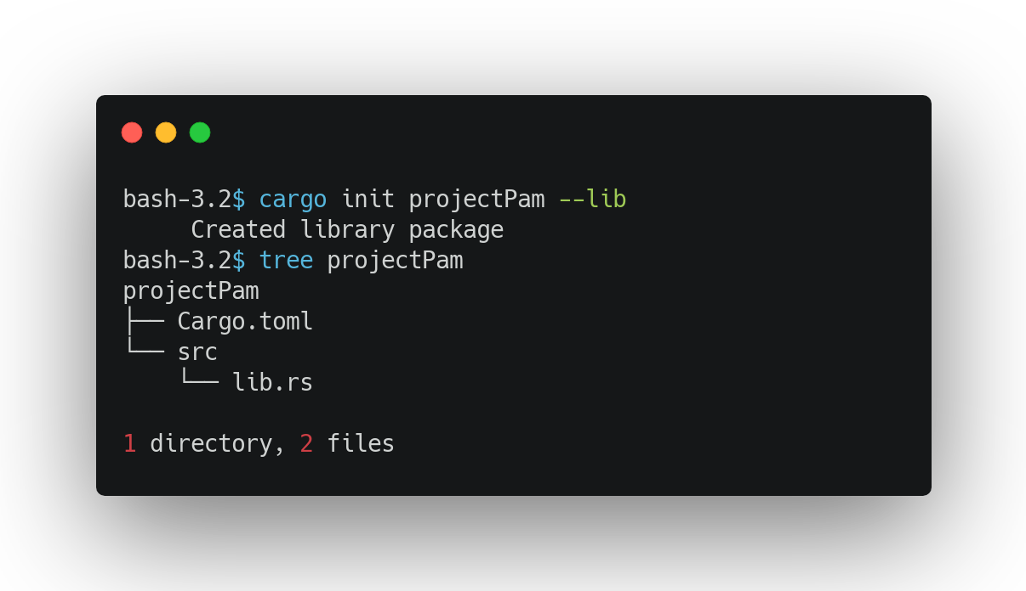
A rust project sctucture
Source code under src
Every file is a module
Also a module could hold several modules
In each files or even in one file
Entry points
For libs: lib.rs
For executable: main.rs

Slide 14
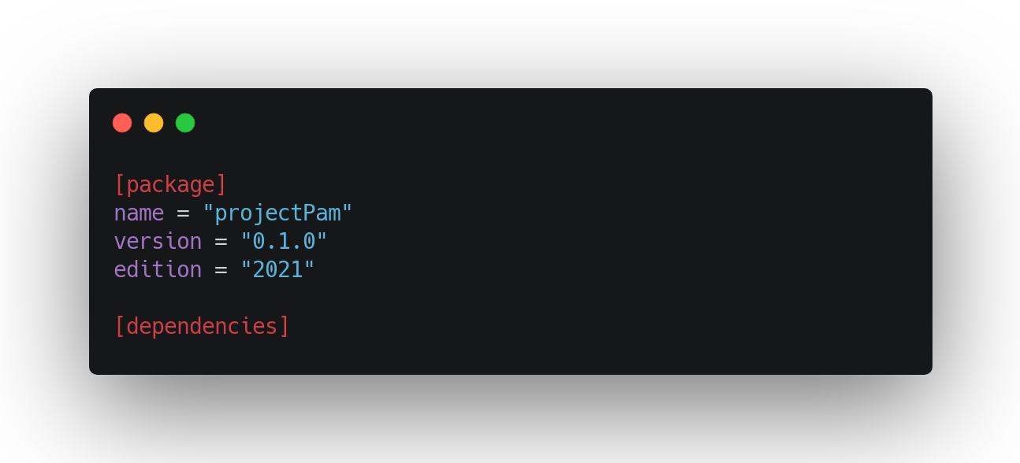

Slide 15
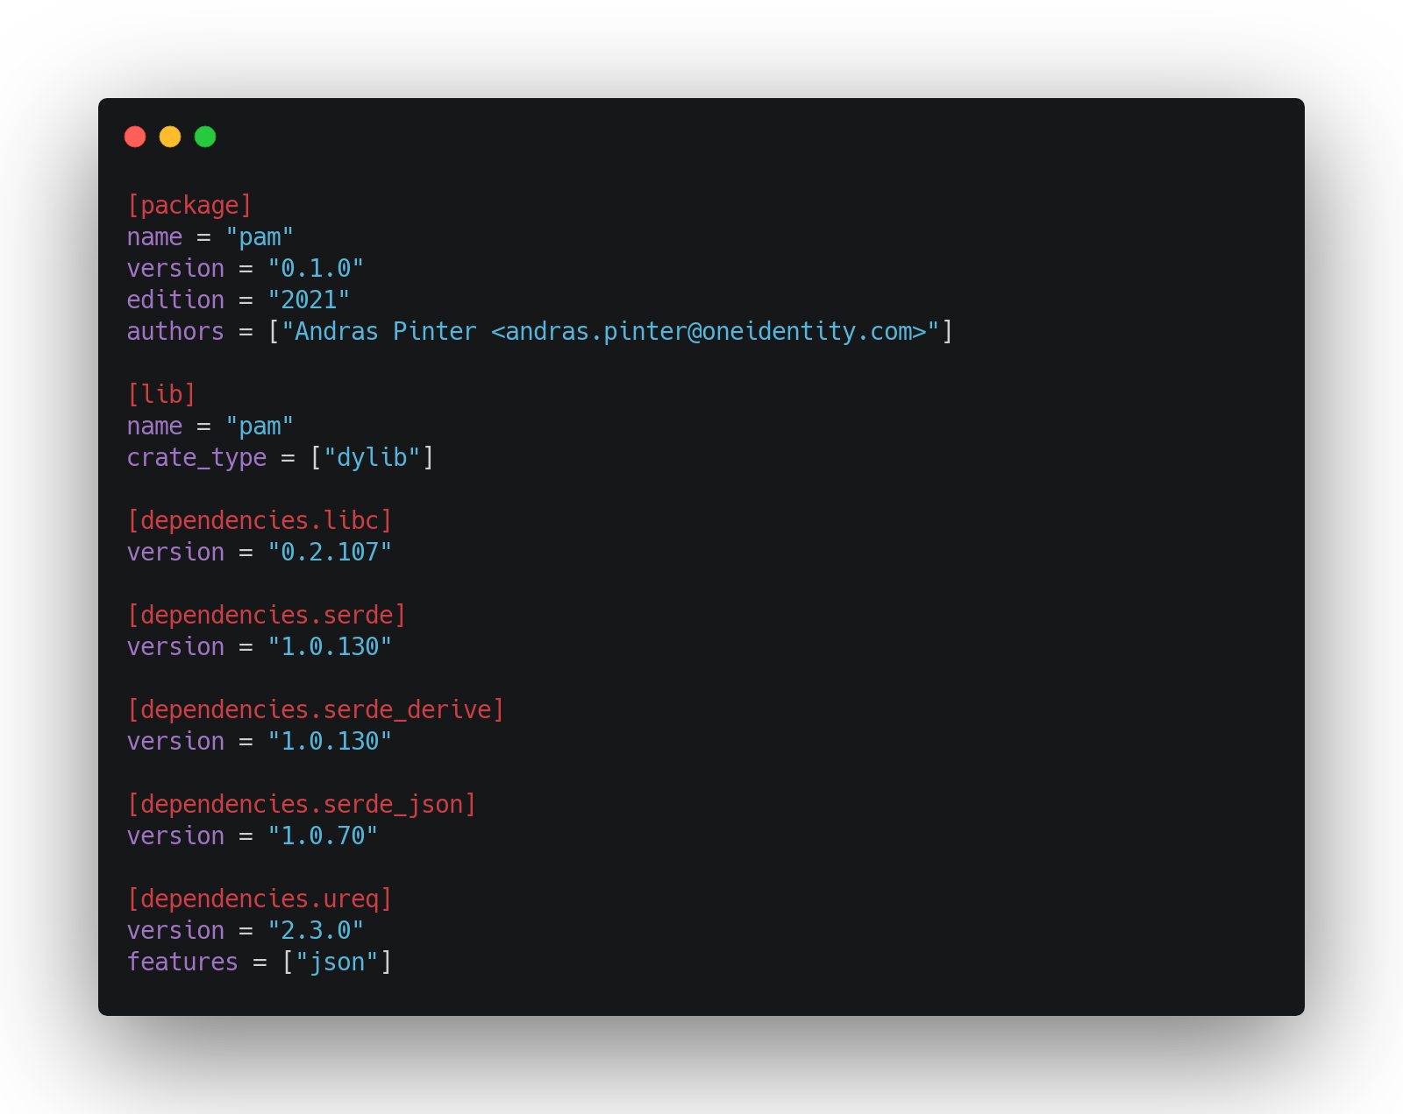
Dynamic rust library
Produces the dynamic library file
Linux: *.so
Mac: *.dylib
WIN: *.dll
Dependecies section
libc: raw ffi bindings to platforms’ system libraries
serde: fast parsing library
serde_*: json parsing extension
ureq: simple http library with json support

Slide 16
Let’s code
Now for real

Slide 17
Symbol mangling in a nutshell
The scheme must provide an unambiguous string encoding for everything that can end up in a binary's symbol table.
No two distinct compiler-generated entities must be mapped to the same symbol name
E.g.: fn foo() {} → NvNvZ7pam3foo
#[no_mangle]
Tells the compiler do not do this!

Slide 18
Pam functions: pam_sm_setcred
Service function to alter credentials
Call after the user has been authenticated but before a session has been established
Providing some information about the user for the application
We will ignore this

Slide 19
Pam functions: pam_sm_acct_mgmt
No authorization or authentication happens here
Any other checks could happen here
Terminal checks
Hostname checks
Expiration of the password
We will ignore this: always success

Slide 20
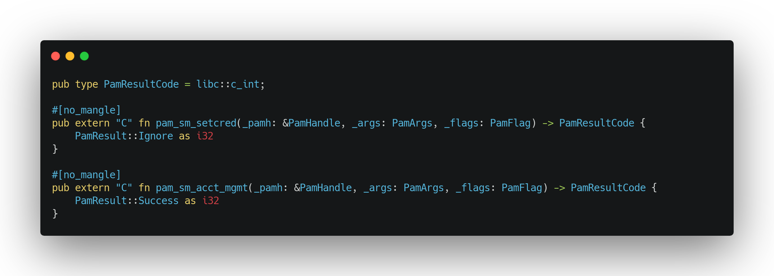

Slide 21
Pam functions: pam_sm_authenticate
The authentication happens here, service function for user authentication
That’s the one we need! So implement it

Slide 22
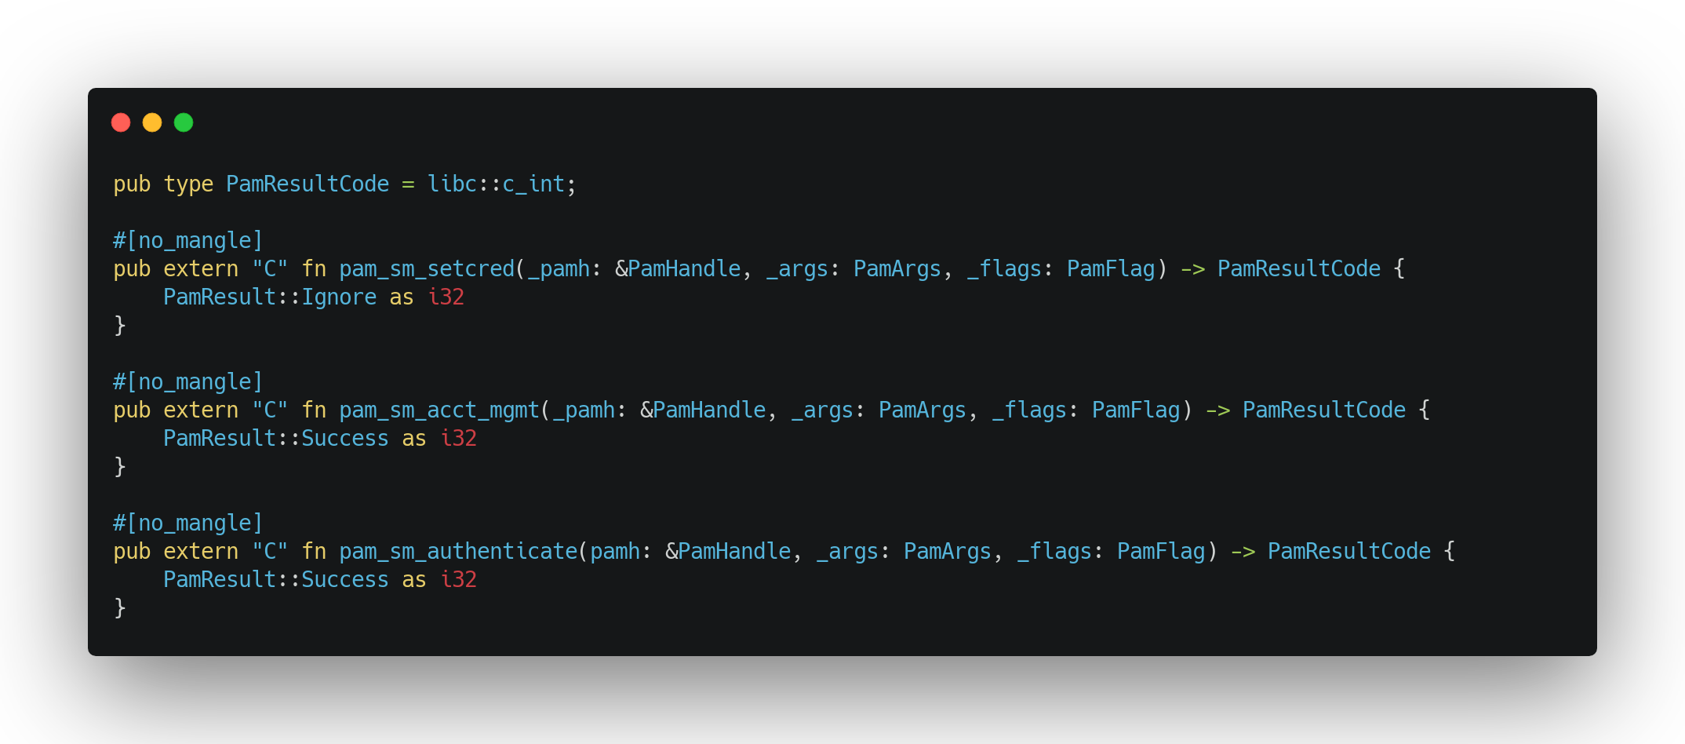

Slide 23
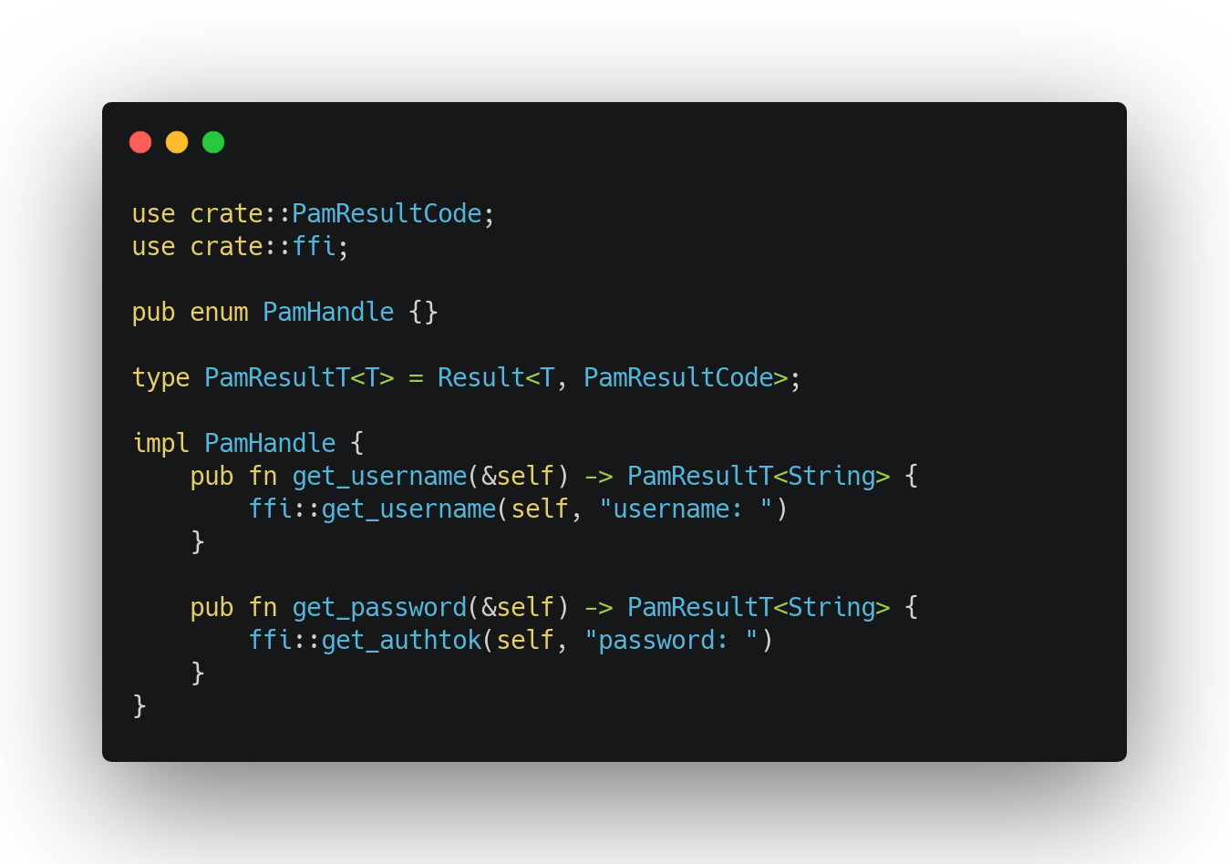
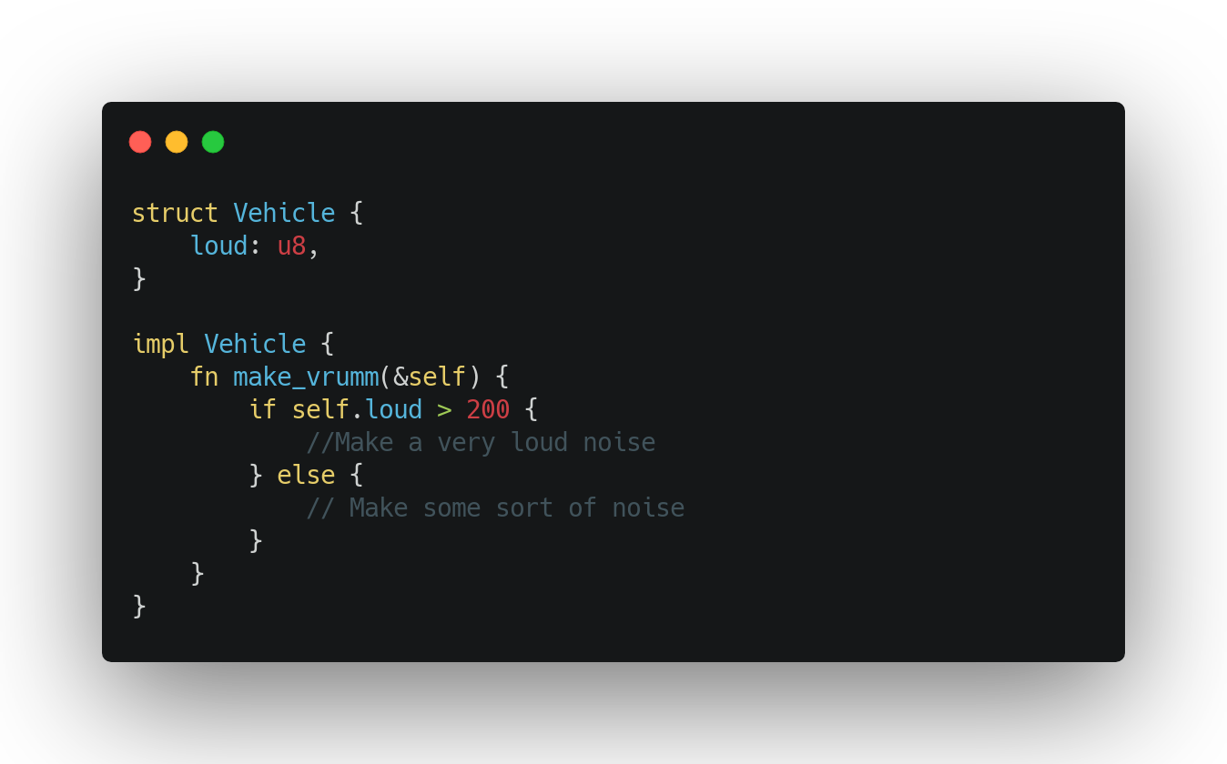
FFI: enums
Only enums could safely shared via an FFI binding
Generics
Impl block
For struct and also for enum
Holds the actual implementation

Slide 24
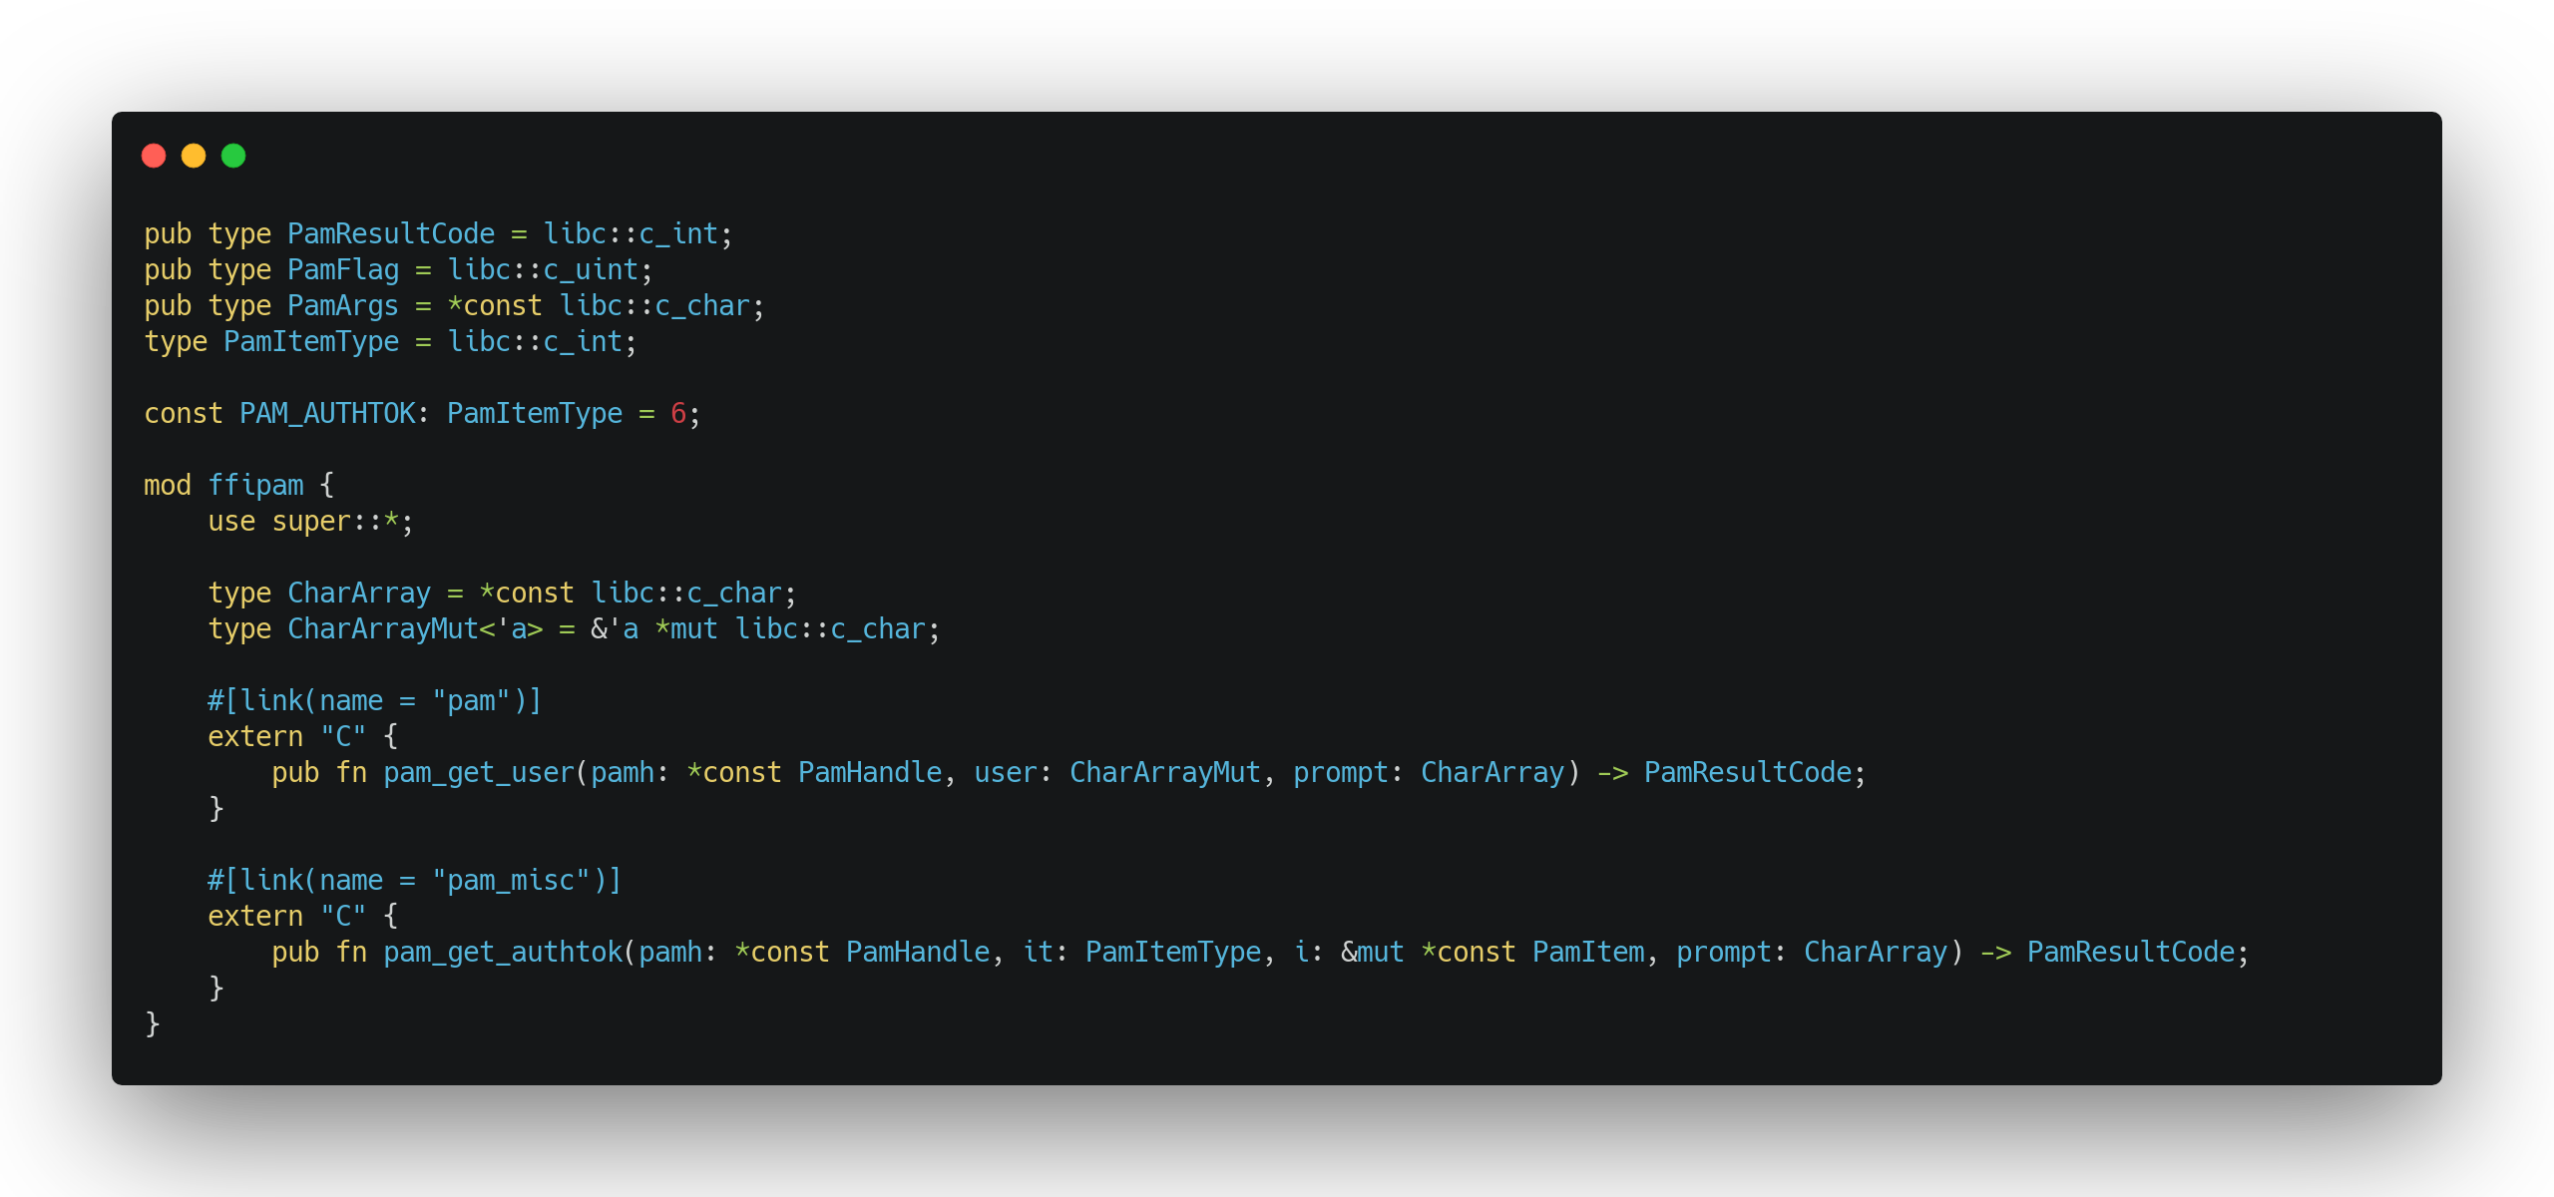
Create ffi
FFI: able to call foreign functions
This is unsafe!
#[link(name = “package”)]
Easy linking to a shared library
pam_get_user
Foreign function from the pam module
e.g.: User to authenticate
pam_get_authtok
Foreign function from the pam module
e.g.: The prompted password

Slide 25
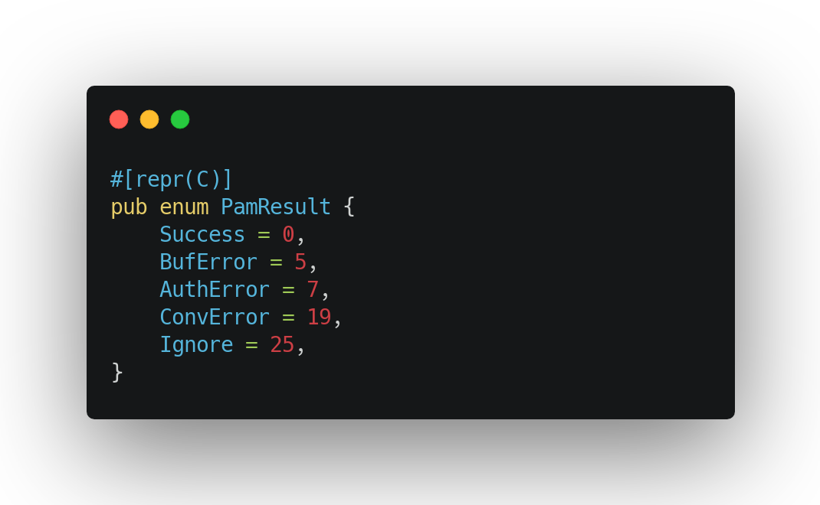
The PamResult enum is a C-like enum wrapper
Result codes in a sigend 32-bit width integer wrapper

Slide 26
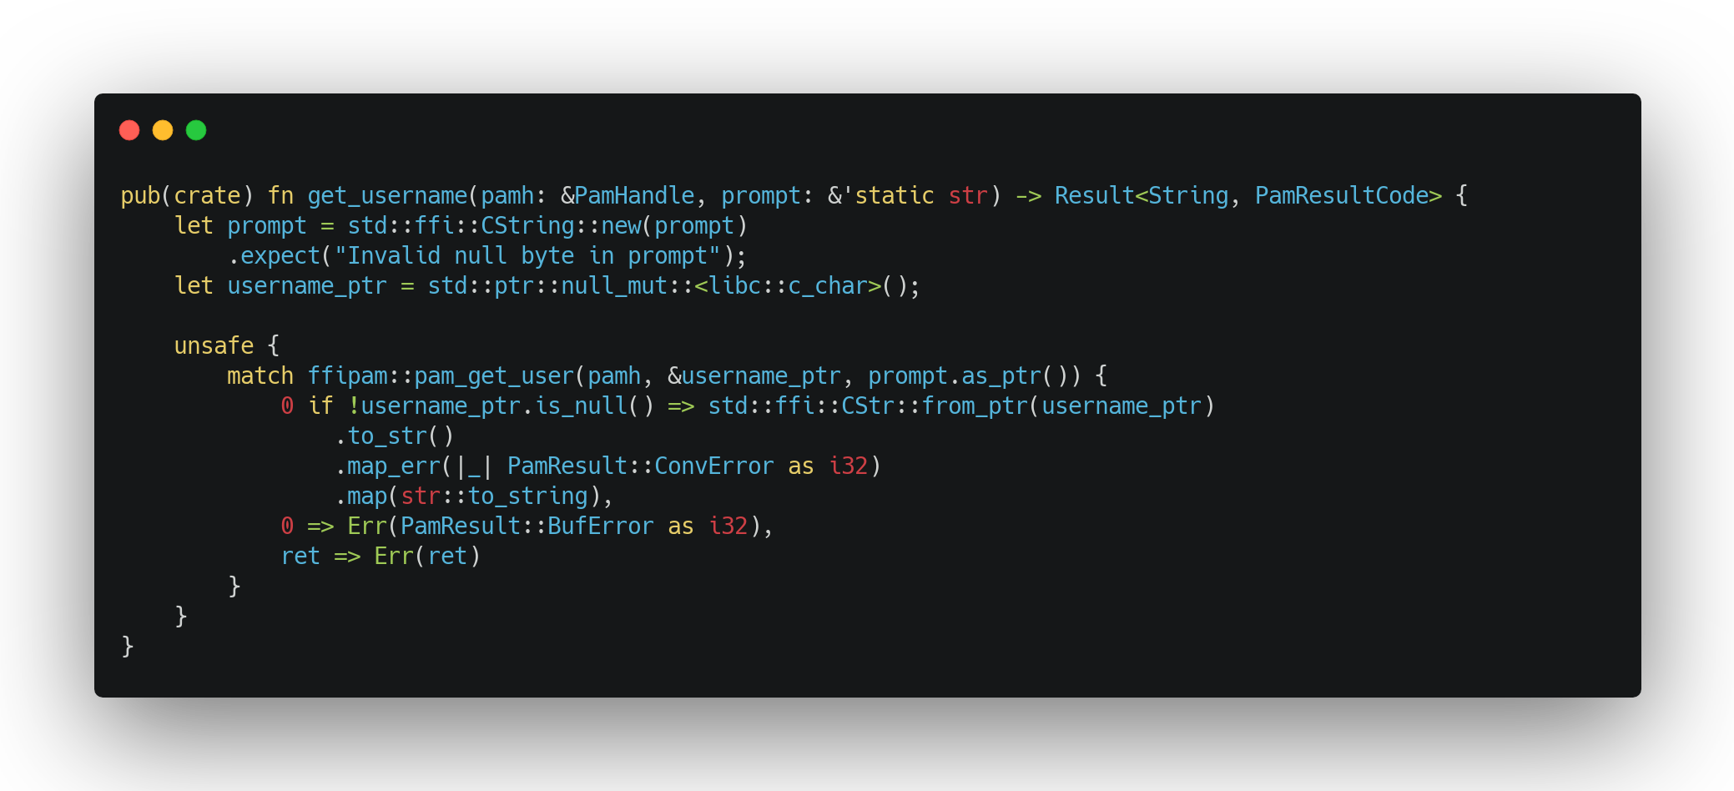
Make it safe
unsafe {}
Let us to call an unsafe code-block
Turn off rust’s safety barriers
Converting rust’s static str to a c-like string
username_ptr pointer will hold the username string from the PAM module
Errors:
The username c-string cannot be converted to a rust string
The username_ptr pointer is null
Any other error: retrun code is not zero

Slide 27
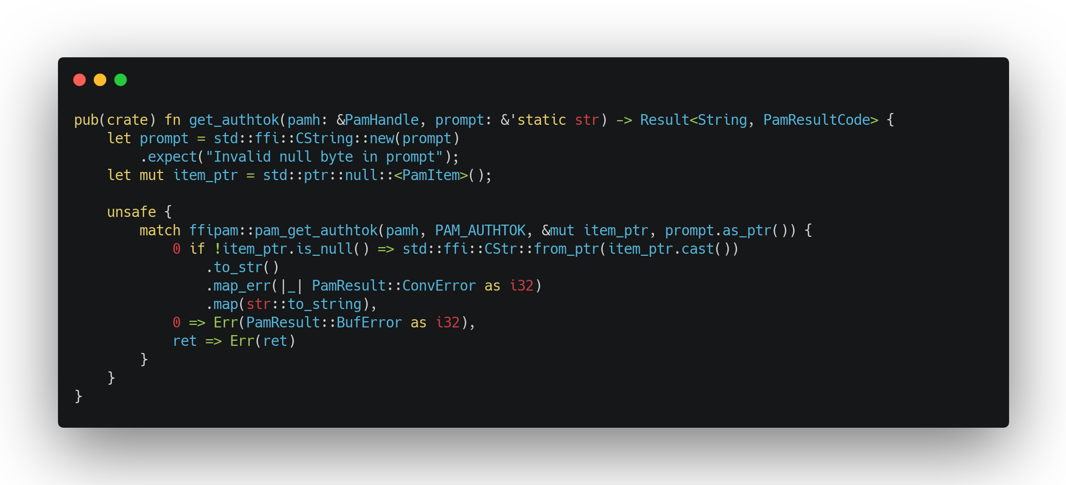
Make it safe
pam_authtok (6)
tell the pam module to return the current authentication token
item_ptr pointer will hold the password string from the pam module
Errors:
the item c-string cannot be converted to a rust string
the item_ptr pointer is null
any other error: retrun code is not zero

Slide 28
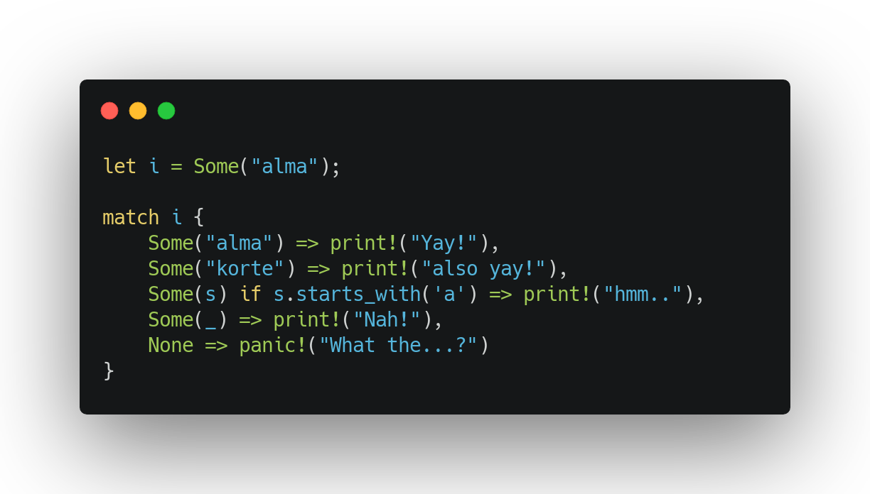
pattern matching in a nutshell
very fast
easy to read
rust will check if all the possibilities covered
warning on unreachable pattern
working on nealry anything
numbers, str, enum-variants, Result<T, E>
embdedd if

Slide 29
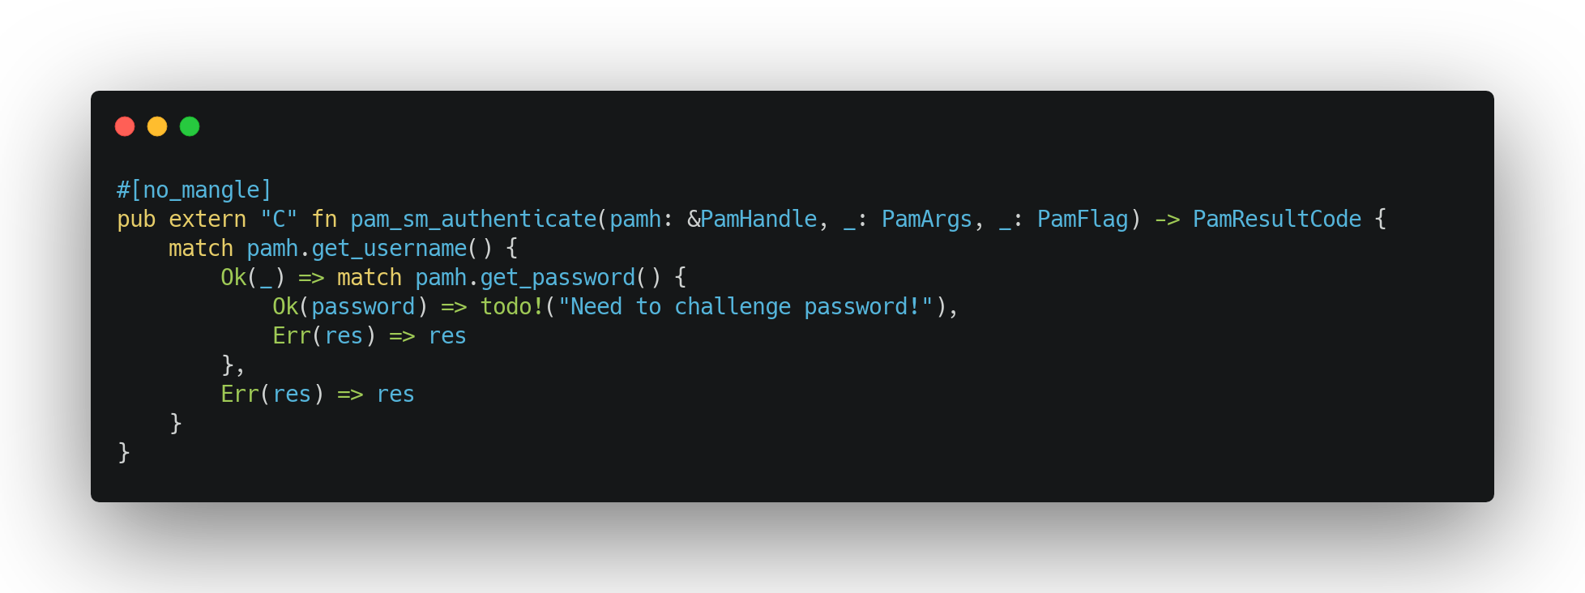
Putting all together
Try to acquire a username from pam
Could be coming from the shell
Could be prompted
Could be cached
Try to acquire the password from pam
Could be prompted
Could be cached
If any error occures, just simply return the result code from the PAM module.

Slide 30
Let’s code
ChallEnge password via the authentication server

Slide 31
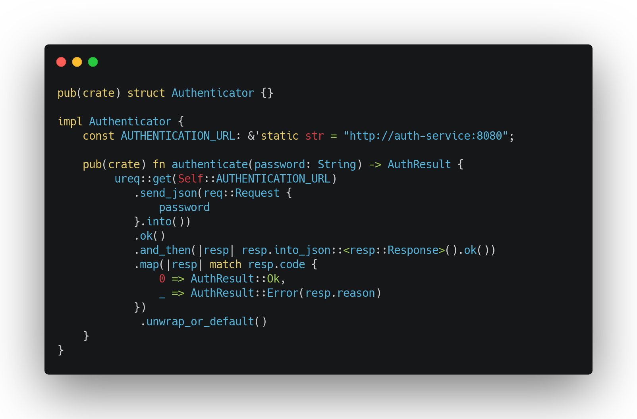
Password request will send towards the Authentication Python Service ‘{“password”: “mypass”}’
The Authentication Python Service will respond with a JSON ‘{“code”: 0x0, “reason”: “Success”}’ OR ‘{“code”: 0x1, “reason”: ”Invalid Password”}’
This message is parsed into JSON and the result returned based on the “code”

Slide 32
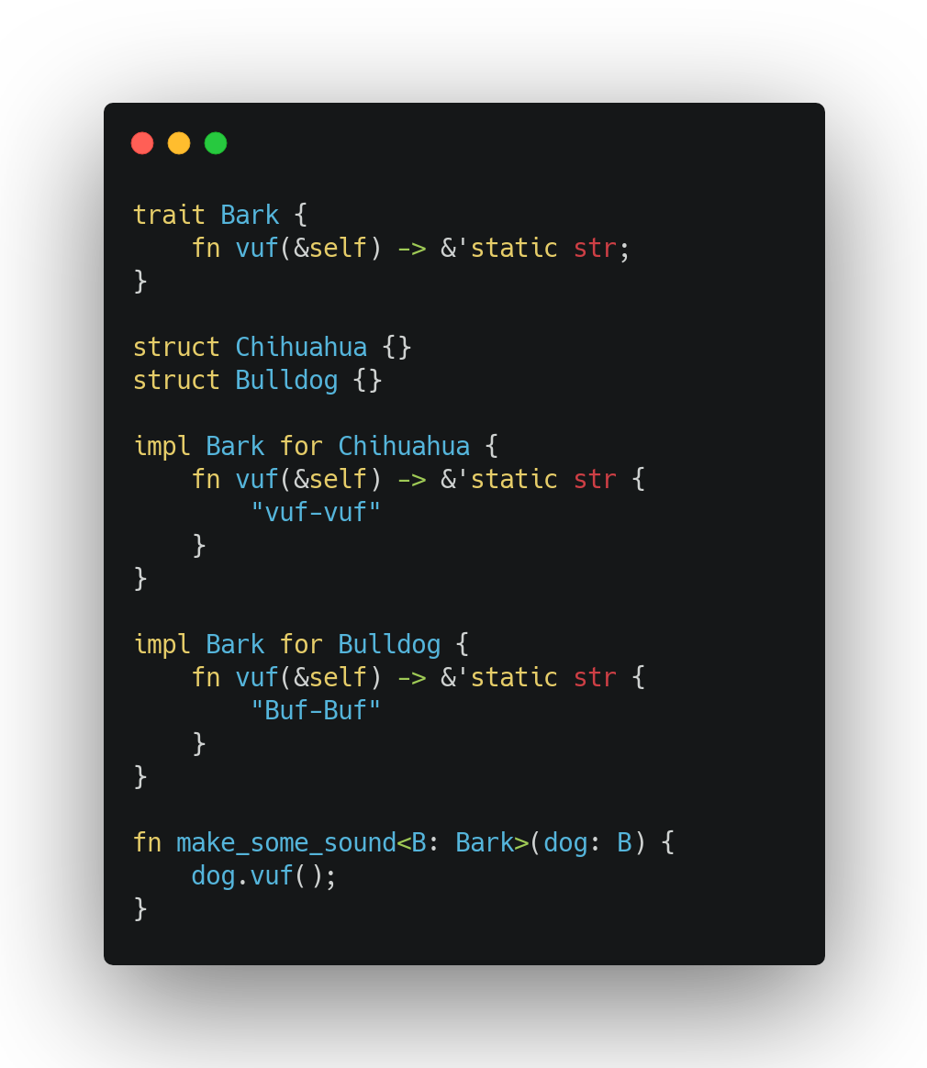
Traits in a nutshell
Shared implementations
Instead of inheritance
Function inputs
accept only those stuctures which implements the following trait
Built-in traits
Into, From
ToString, AsRef
Default
etc

Slide 33
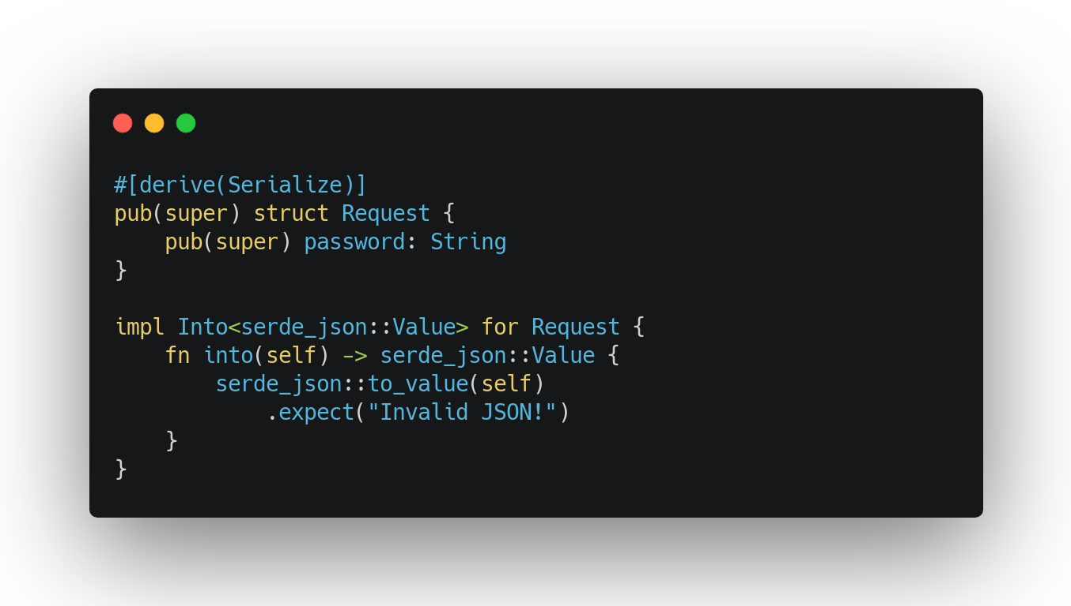
#[derive(Serialize)]
Make the underlying struct JSON serializable
Into JSON trait
converts the structure into a well-formated JSON

Slide 34
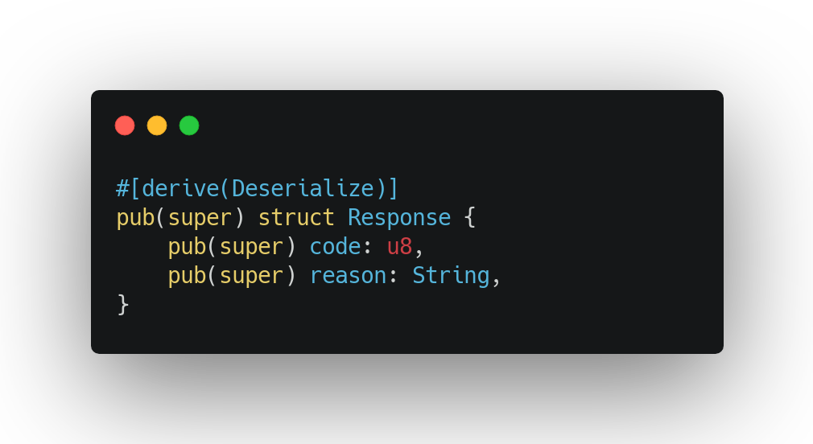
#[derive(Deserialize)]
Make the underlying struct JSON deserializable

Slide 35
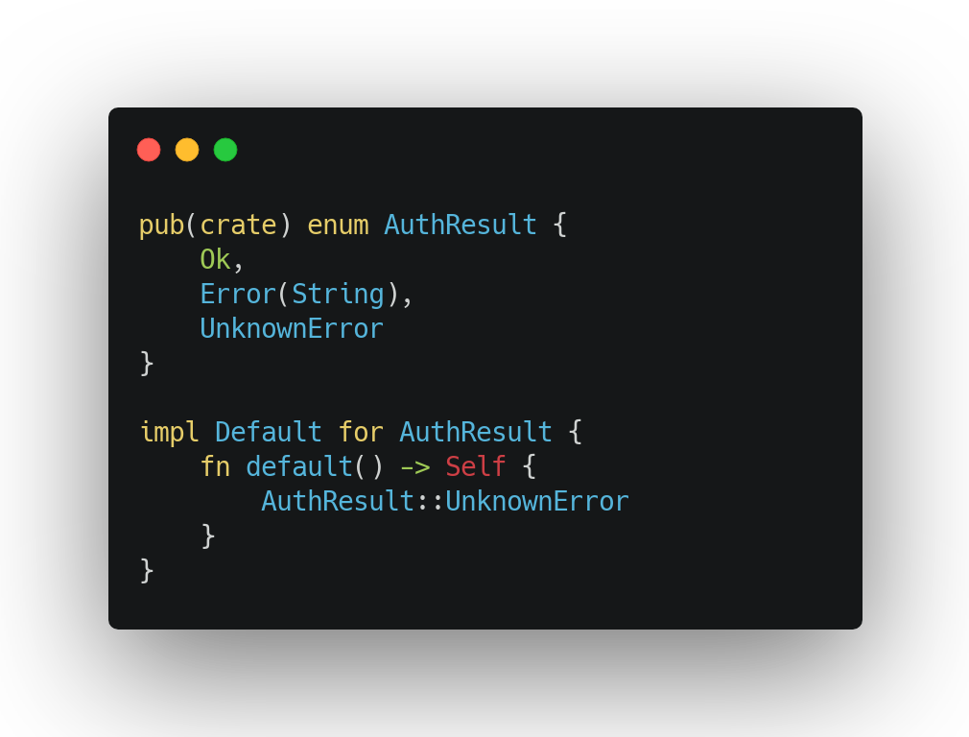
Authentication Service result
Variants
Ok: authentication successful
Error: there is a known error, and the response holds the reason
UnknownError: there is a unknown error
The Default trait implementation indicates which variant of the Enum should use, if the variant not specified

Slide 36
Send a GET request with the JSON body
It returns a Result<T, E>, so with ‘.ok()’ convert it to an Option<T>
If there is a Some<Response>, then parse into the Response struct
Check the code field of the Response struct
If it’s 0, then return Ok
If isn’t 0, then return the Error with the reason
If no response got back or there was an error, return the Default value of the AuthResult, which is UnknownError

Slide 37
Let’s code
Putting all together

Slide 38
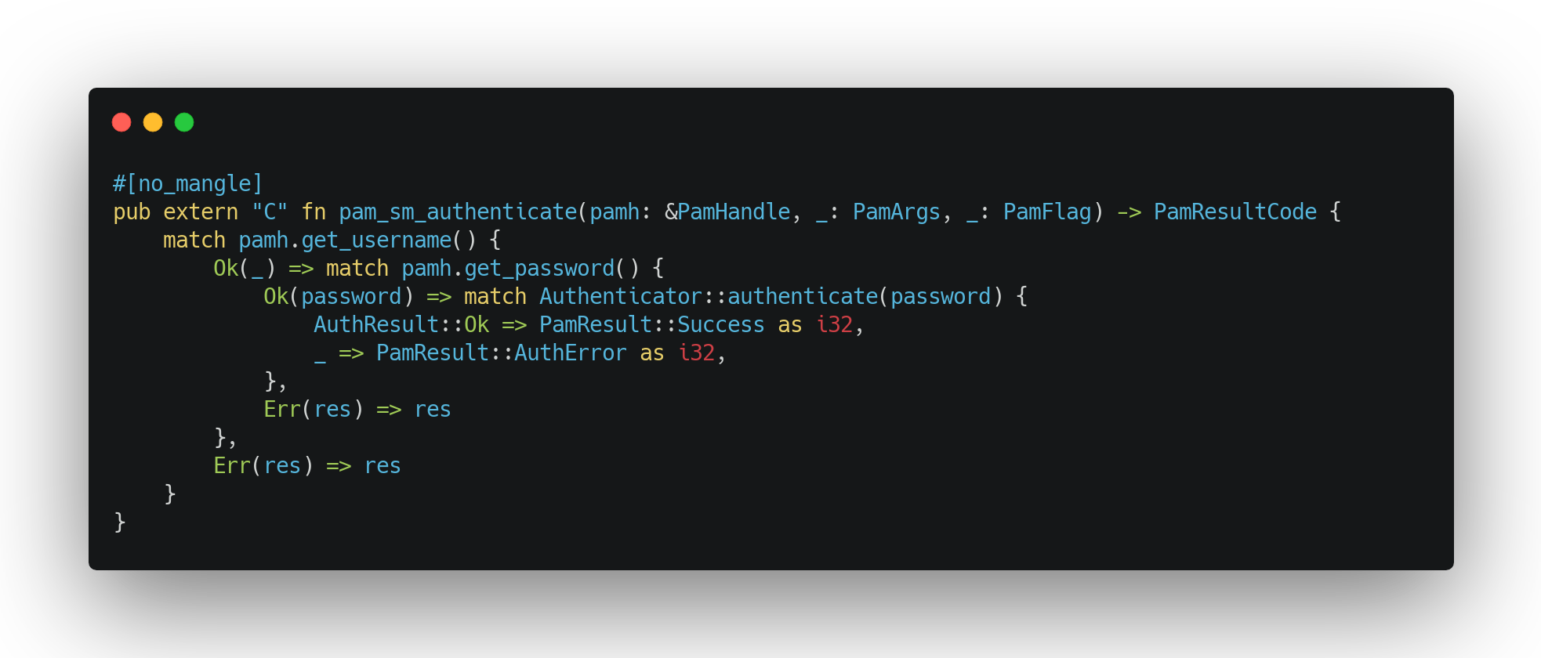
Putting all together #2
Try to acquire a username from pam
Could be coming from the shell
Could be prompted
Could be cached
Try to acquire the password from pam
Could be prompted
Could be cached
Challenge the password with the Authetication Server
If the result is Ok, then the authentication successful
Otherwise, the authentication faile
If any error occures, just simply return the result code from the PAM module.

Slide 39
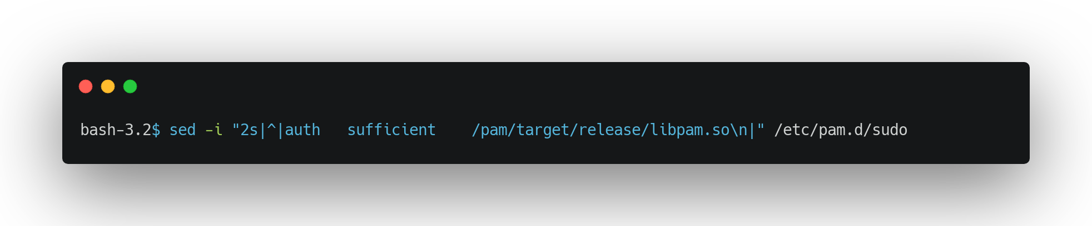
Make sudo to use our module

Slide 40
Live demo
Q&A session

Slide 41
Resources
github: https://github.com/andras-pinter/meetup
Presentation: Ask meetup team

Slide 42


Thank you for attention

